Slide 1

Cyber Relation Extraction from Unstructured Documents
Stucco Component Presentation
Isaac Persing
The University of Texas at Dallas
2016-08-11
Notes:
Thank you for coming to my presentation on “Cyber Relation Extraction from Unstructured Documents”
-which is the component of Stucco I have been working on for the past couple months.

Slide 2
Collect and Organize Security Data for Contextual Understanding
Stucco

Slide 3
Stucco Motivation
[**] 1:234:56 IRC - Channel JOIN [**]
[Classification: A Network Trojan was detected]
09/04-17:11:45.456789
10.32.92.230:6667 -> 69.42.215.170:33982 {TCP}
TTL: 34 TOS:0x0 ID:3456 IpLen:20 DgmLen: 44 ******S*
Seq: 0x12345678 Ack: 0x0 Win: 0x400
TcpLen: 24 TCP Options (1) => MSS: 1440
[Xref => http://cve.mitre.org/CVE-2002-1675]
Notes:
-This is an “alert” that something bad happened.
-Analysts get lots of alerts like this.
-Alerts are “information impoverished”
-What are those IPs?
-What vulnerability was exploited?
-How to fix it?
Security analysts have a variety of different automated systems to assist them in keeping networks safe.
- Host based intrusion detection
- NIDs
- Firewalls
- various logs, ..
But a large amount of manual investigations that are undertaken in order to make sense of their data.
Typical example, here. can see a little bit of information - IRC...

Slide 4
Stucco: Project Overview
Goal: Provide situational awareness for understanding (and protecting) a computer network
Need: Data is diverse in nature and location, and therefore time-consuming to find and digest
Means: Collect, correlate, and make accessible diverse data to enable decision making

Slide 5
Sample of Data Sources
Endogenous Data
Software (internal config. + CPE)
Hardware (internal config)
Flows (Hone, Argus)
Firewall logs
Snort alerts
Authorization logs
Exogenous Data
Malware
Exploits (Metasploit)
Vulnerabilities (NVD, CVE)
Geographic IP address (GeoIP)
Blacklists
Unstructured text
Notes:
-Endogenous data – within the network
-Exogenous data – outside of the network
-Stucco gathers this all into one place
-We will focus on unstructured data

Slide 6
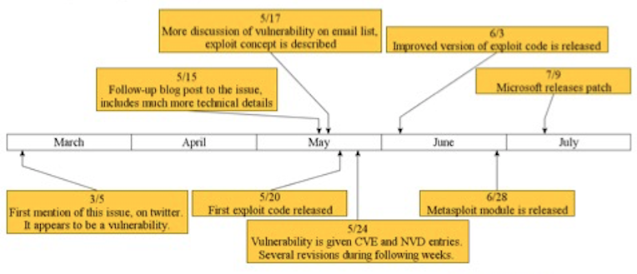
Enter Natural Language Processing
Want to automatically identify and extract important information from text
Compelling example:
Image Credit: McNeil et al. “PACE: Pattern accurate computationally efficient bootstrapping for timely discovery of cyber-security concepts.” ICMLA 2013.
Notes:
4 months from first mention to patch.
If an analyst knew about the information in the tweet, or even the information in the blog discussion and email list awhile later, they’d be able to take precautions against the exploit code on 5/20. Or at least they’d be able to understand what happened if they were targeted.

Slide 7
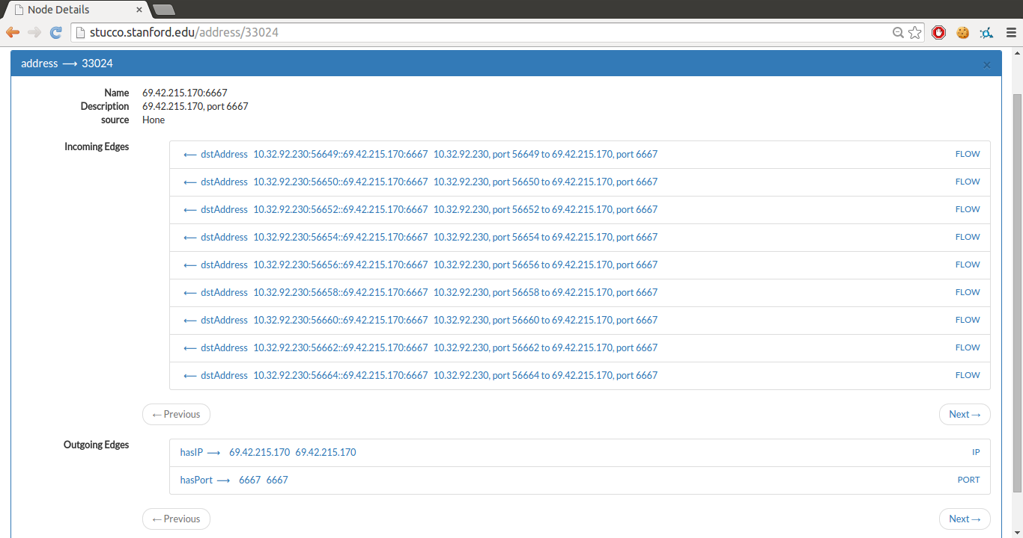
Stucco Approach
Continuously collect data from enterprise and open sources
Extract domain information from structured (e.g. STIX) and unstructured data sources
Align data into a knowledge graph, merging data rather than adding duplicate data
Provide an API for programmatic access and a user interface for exploring the graph

Slide 8
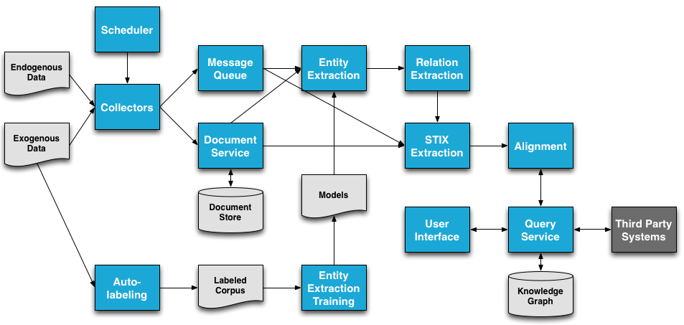
Architecture Overview
Notes:
-Start with endogenous, exogenous data.
-Go left to get to knowledge graph.
-Stucco fills in all those things between.

Slide 9
Architecture Overview

Slide 10
Collecting Data from Unstructured Sources
Constructed a list of cyber security relevant unstructured document sources
Configured collector to extract documents at regular intervals
Debugged collector pipeline
Currently collecting documents
Collected 174 documents in first 5 hours
Collection works in real-time
Notes:
-Present as success.
-This stuff wasn’t done.
-There were a bunch of bugs.
-We did it.

Slide 11
Unstructured Data Sources
Microsoft Comprehensive Security Alerts
Microsoft Security Response Center
Microsoft Security Advisories
Oracle Alerts
Apple Security Announcements
Symantec Security Response
SANS Internet Storm Center
Sophos Naked Security
Krebs on Security
F-Secure News from the Lab
Team Cymru Research
Spamhaus News
Wired: Threat Level
Schneier on Security
McAfee Blog
Kaspersky Secure List
Computer World Security Blog
Stack Exchange Security Blog
Ars Technica: Risk Assesment
CNet Security
RSA: Speaking of Security
Forbes: Firewall
Jeremiah Grossman Blog
security.stackexchange.com
Tao Security Blog
slashdot
Security Week
Computer World
Security Street
Threat Post
Malware Bytes
Securelist Malware Descriptions
The Hacker News
Trend Micro
Securelist
Darknet
AUS-CERT
Xforce Security Intelligence
Dark Reading
Windows Security
Packetstorm News
Kaspersky security matters blog

Slide 12
Collector Configuration
demo:
collectors:
-
type: RSS
data-type: unstructured
source-name: Microsoft Comprehensive Security Alerts
source-URI: http://technet.microsoft.com/en-us/security/rss/comprehensive
post-process: removeHTML
content-type : text/html
now-collect: all
cron: 0 40 * * * ?
-
type: RSS
data-type: unstructured
source-name: Microsoft Security Response Center
source-URI: http://blogs.technet.com/b/msrc/atom.aspx
post-process: removeHTML
content-type : text/html
now-collect: all
cron: 0 40 * * * ?
-
…

Slide 13
Debugging Collector
Content goes here.

Slide 14
Collecting Documents
Collected 174 documents in first 5 hours
Collection works in real-time

Slide 15
Processing Unstructured Documents
Documents are parsed
Words and sentences tokenized
Words lemmatized
Words part of speech tagged
Sentences syntactically parsed
Sentences dependency parsed
Entities Labeled
Heuristic labels applied
Maximum entropy model
Relation Extraction

Slide 16
Entity Types
File Name
Function Name
Software Product
Software Vendor
Software Version
Vulnerability CVE ID
Vulnerability Description
Vulnerability MS ID
Vulnerability Name

Slide 17
Relation Types
SOFTWARE_VENDOR is vendor of SOFTWARE_PRODUCT
SOFTWARE_VERSION is version of SOFTWARE_PRODUCT
VULNERABILITY_DESCRIPTION describes VULNERABILITY_NAME
VULNERABILITY_MS_ID describes VULNERABILITY_NAME
VULNERABILITY_CVE_ID is named VULNERABILITY_NAME
VULNERABILITY_DESCRIPTION describes VULNERABILITY_MS_ID
VULNERABILITY_DESCRIPTION describes VULNERABILITY_CVE_ID
VULNERABILITY_CVE_ID is ID for VULNERABILITY_MS_ID
SOFTWARE_PRODUCT is vulnerable to VULNERABILITY_NAME
SOFTWARE_PRODUCT is vulnerable to VULNERABILITY_MS_ID
SOFTWARE_PRODUCT is vulnerable to VULNERABILITY_CVE_ID
SOFTWARE_VERSION is vulnerable to VULNERABILITY_NAME
SOFTWARE_VERSION is vulnerable to VULNERABILITY_MS_ID
SOFTWARE_VERSION is vulnerable to VULNERABILITY_CVE_ID
SOFTWARE_PRODUCT has vulnerability related to FILE_NAME
SOFTWARE_VERSION has a vulnerability related to FILE_NAME
SOFTWARE_PRODUCT has a vulnerability in FUNCTION_NAME
SOFTWARE_VERSION has a vulnerability in FUNCTION_NAME
VULNERABILITY_NAME is related to FILE_NAME
VULNERABILITY_CVE_ID is related to FILE_NAME
VULNERABILITY_MS_ID is related to FILE_NAME
VULNERABILITY_NAME is related to FUNCTION_NAME
VULNERABILITY_CVE_ID is related to FUNCTION_NAME
VULNERABILITY_MS_ID is related to FUNCTION_NAME

Slide 18
Relation Extraction Components
Collection of large set of security documents
Corpus of positive and negative relation examples created from structured and unstructured sources
Leverage known data to make a training corpus
Construction of task-relevant feature set
Supervised learning for binary classification
Input: Sentence with entity pair identified
Output: Relation exists or not
Notes:
Outline Slide

Slide 19
Document Collection for Relation Extraction
Initial implementation on ~100 unstructured documents
Enough for testing code/proof of concept
Ideally, would have ~100,000 unstructured documents for training and evaluation of relation extractor

Slide 20
Creation of Positive and Negative Examples
Extract sentences containing two possibly related entities.
Positive examples involve related entities.
Microsoft released 11 security updates to fix vulnerabilities more than 40 flaws in Windows and related software.
Microsoft is vendor of Windows
Negative examples involve unrelated entities.
…the latest, patched Flash version 22.0.0.209 for Windows and Mac systems is still available.
Mac is not vendor of Flash
Notes:
-Explain that text colors mean we automatically extracted extracted these as entities.
-there may be more entities in here, but we only highlighted relevant ones.

Slide 21
Extract Relationships from National Vulnerability Database (NVD)
Collect NVD dumps from 2002 to present
Each entry describes a vulnerability:
But some items are not readily accessible
Example: vulnerability name not available for every vulnerability, and appears in the natural language summary
The Microsoft (1) VBScript 5.7 and 5.8 and (2) JScript 5.7 and 5.8 engines, as used in Internet Explorer 8 through 11 and other products, allow remote attackers to execute arbitrary code via a crafted web site, aka "Scripting Engine Memory Corruption Vulnerability.”
Augment relations extracted with Freebase knowledge
Heuristic labeling
If both entities appear related in relation list, example is positive.
If both entities appear in list of relations, but not together (i.e. they are related, but not to each other), example is negative.
Name
CVE ID
Related MS ID
Description words
Files it exploits
Functions it exploits
Products it affects
Product vendors
Product versions

Slide 22
Heuristically Labeling Relationship Examples
If both entities appear related in relation list, example is positive.
If both entities appear in list of relations, but not together (i.e. they are related, but not to each other), example is negative.

Slide 23
Goal of Example Representation
“Microsoft released 11 security updates to fix vulnerabilities more than 40 flaws in Windows and related software”
“Adobe has pushed out a critical update to plug at least 52 security holes in its widely-used Flash browser plugin”
Entities having same relationship should share similar contexts.
Encode examples such that, if they have similar contexts, they have similar representations.

Slide 24
Feature Set
Context lemma n-grams
Syntactic parse tree path
Context lengths
Dependency tree path
Context entity counts
Context lemma embeddings

Slide 25
Feature: Context Lemma N-grams
Original: Adobe issued a critical update for its Flash Player software.
Lemmatized: Adobe issue a critical update for its Flash Player software .
Lemmatization
Extract from text Before, Between, and After
Sequences of 1, 2, and 3 lemmas
Between-issue
Between-issue-a-critical
Between-update-for
After-software-.

Slide 26
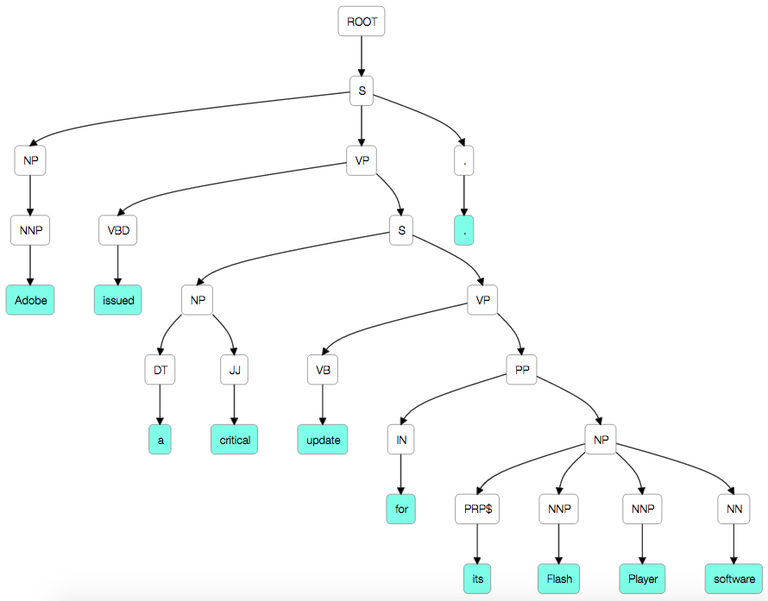
Feature: Syntactic Parse Tree Path
Extract label sequence between entities’ last words.
Example: NNP-NP-S-VP-S-VP-PP-NP-NNP
Image credit: http://nlpviz.bpodgursky.com/

Slide 27
Feature: Context Lengths
Adobe issue a critical update for its Flash Player software .
Extract token counts Before, Between, and After
Before: 0
Between: 6
After: 2

Slide 28
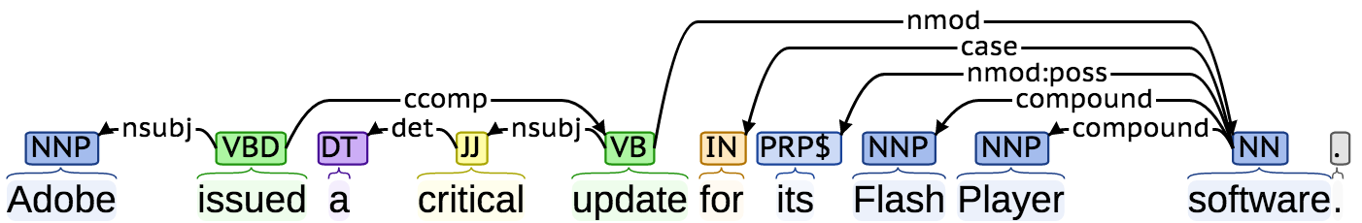
Feature: Dependency Path
Extract edge sequence between entities’ last words.
<-nsubj->ccomp->nmod->compound
Extract lemma sequence between entities’ last words.
issue-update-software
Extract edge and label sequence between entities’ last words.
<-nsubj-issue->ccomp-update->nmod-software->compound
Image credit: http://nlp.stanford.edu:8080/corenlp/process
Notes:
Ccomp is “clausal complement”
Det is “determiner”

Slide 29
Feature: Context Entity Counts
Microsoft and Google released updates to their Internet Explorer and Chrome browsers, respectively.
Count entities of other types occurring Before, Between, and After
Between-Software_Vendor:1
Between-Software_Product:1

Slide 30
Feature: Context Lemma Embeddings
Adobe issue a critical update for its Flash Player software .
Extract bag of lemmas Before, Between, and After
Before: “”
Between: “issue a critical update for its”
After: “software .”
Embed each bag in vector space that represents it semantically.
Get vector representation of each lemma from word2vec model
Average lemma vectors

Slide 31
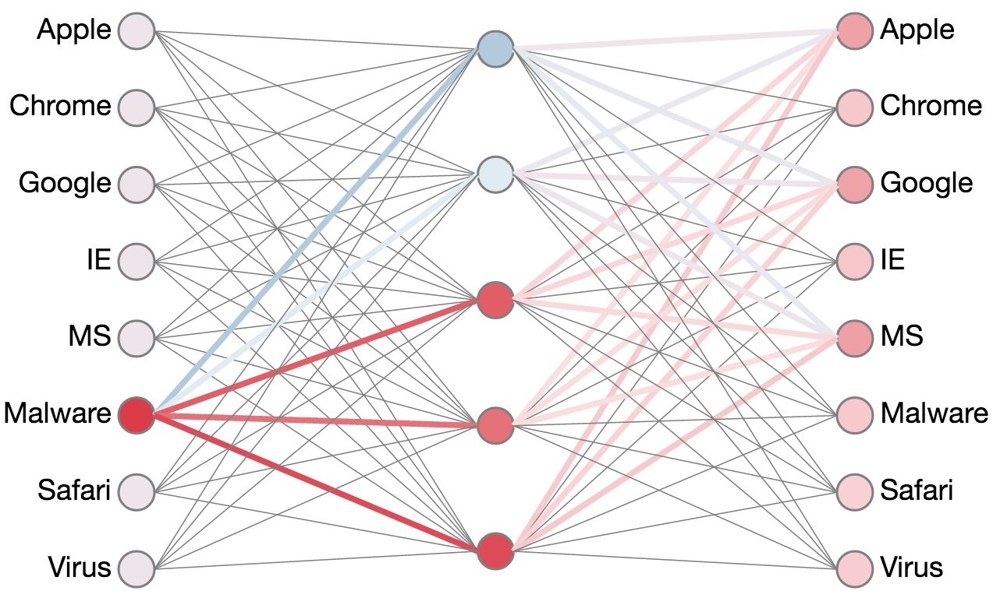
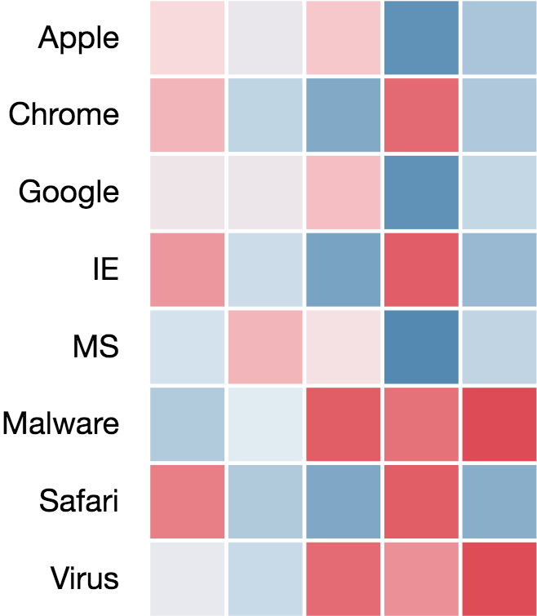
Feature: Context Lemma Embeddings What is Word2vec?
Semantically similar words have similar context
Train a neural net on many documents
Input: a word
Output prediction: word’s context
After training, semantically similar words have similar feature vector representations
Vectors after training
Simple Neural Net
Image credit: https://ronxin.github.io/wevi/

Slide 32
Feature: Context Lemma Embeddings Word2vec: How We Use It
Train word2vec model on:
7 million Wikipedia articles.
Cyber Security documents oversampled 100 times.
100 hidden units
Skip grams with 5 word context window
Vocabulary words must occur > 100 times
Training takes 5 days with 7 2.5 GHz cores, but only has to be done once
Word2vec feature representation stored for each word, i.e., we have a key-value store of the form
Word : Feature Vector
Python Gensim Reference: Řehůřek, R., and P. Sojka. "Gensim–Python Framework for Vector Space Mo delling." NLP Centre, Faculty of Informatics, Masaryk University, Brno, Czech Republic (2011).

Slide 33
Dependency Path Lemma Embeddings
Extract bag of lemmas between entities’ last words.
issue, update, software
Embed bag in a vector space that represents it semantically.
Get vector representation of each lemma from word2vec model
Average lemma vectors
Image credit: http://nlp.stanford.edu:8080/corenlp/process

Slide 34
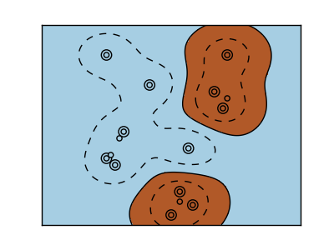
Kernel SVM for Each Relation
Input: Sentence containing entity pair that could share the relation
Represent sentence as some subset of features
Label applied heuristically
Output:
1 if entities do share the relation
-1 if entities don’t share the relation
Kernels to begin testing
Linear kernel k(x,y) = x • y
Radial basis k(x,y) = Exp( - || x – y ||² ⁄ 2σ )
Photo Credit: sk-learn.org
Java LIBSVM Refernce :Chang, Chih-Chung, and Chih-Jen Lin. "LIBSVM: a library for support vector machines." ACM Transactions on Intelligent Systems and Technology (TIST) 2.3 (2011): 27.
Notes:
-Kernels allow us not to have linear boundaries.

Slide 35
SVM’s Training
24 relations (need two SVMs each, one for each entity ordering)
User settings
2 Kernels (RBF, linear) to try
4 values of c ∈ {0.01, 0.1, 1.0, 10.0}
5 values for RBF of γ ∈ {0.0001, 0.001, 0.01, 0.1, 1.0}
5-fold cross-validation
60 % training, 20% development, 20% testing
In all it’s (24*2)*((4*5)+(4)) = 1,152 SVMs tested on 5 folds each!
Notes:
You might also note that, even though this seems like a lot of SVMs, this also only has to be done once once we’ve got enough training data. We save models trained on the training data using all combinations of these parameters so they can quickly be applied to new documents.
-c regularization
-γ variance

Slide 36
Evaluation
5-fold cross-validation
On Vendor produces Product relationship
256 examples from ~100 documents
Baseline:
Uses context lemma n-grams, syntactic parse tree paths
Precision: 0.369 Recall: 0.532 F-score: 0.436
Complete:
Uses all feature types
Precision: 0.391 Recall: 0.660 F-score: 0.491
10% relative error reduction in f-score
Performance should improve with more training data.
Too many ways to express relationships to capture with this few examples
Should have ~100,000 documents

Slide 37
Future Improvements?
Feature selection
Twitter feeds
Probabilistic predictions
Fix document processing pipeline
Expectation maximization
New example-labeling heuristics
Coreference
Semantic parsing
Penn discourse treebank relations
Conflict Resolution

Slide 38
Questions?
Thank you for coming.
Isaac Persing
persingq@hlt.utdallas.edu

